Slide 1
Ubiquitous Comp Final Project
Win Barua
100277378

Slide 2
Introduction
Measure user’s heart rate from 10s video of fingertip with the flashlight on.
Use this alongside other user data to calculate the calories burned during a period of exercise.
Train an activity recognition model
Implement both together to create a system that could be used for logging the activity the user has done and the amount of calories burned

Slide 3
Sensors & Data Collection
Created an android application to collect sensor data
Collects accelerometer data
BPM uses camera sensors with flash

Slide 4
Processing
calculate_bpm
ml_model
Extract frames
Convert to HSV
Create an array of colour values
Plot array on graph to create cardiogram
Put data in correct format
Balance data
Standardize data
Setup model
Save model

Slide 5
Output
calculate_bpm
Extract frames
Convert to HSV
Create an array of colour values
Plot array on graph to create cardiogram
display_activitiesandcalories
Get bpm
Prepare sensor data
Get prediction
Ask user questions
Display information
ml_model
Put data in correct format
Balance data
Standardize data
Setup model
Save model

Slide 6
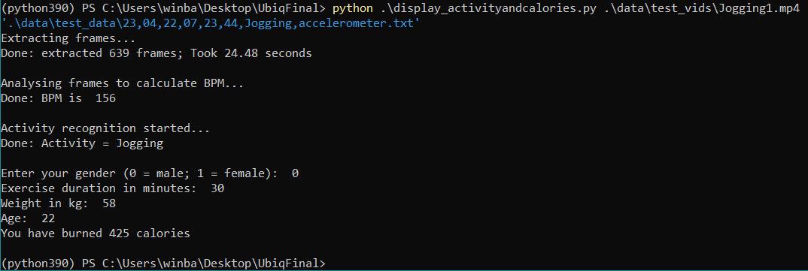
Output 2

Slide 7
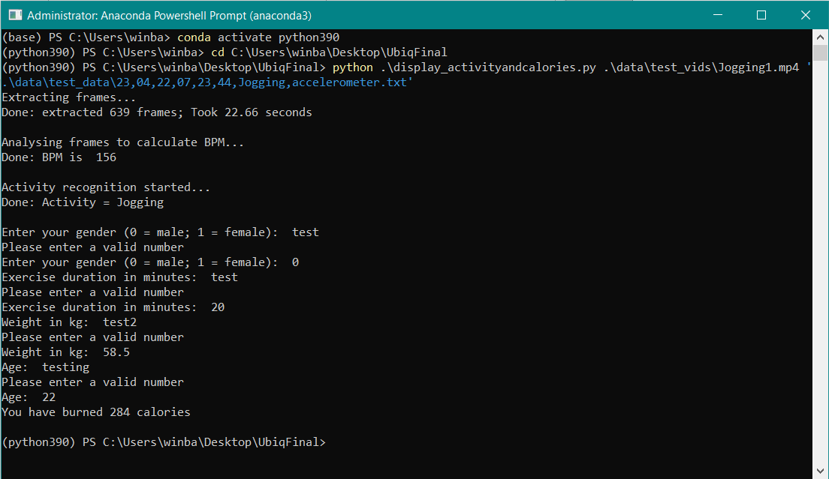
Testing

Slide 8
Demonstration
Demonstration of how the system works.

